Slide 1
Unit-2 Part A Introduction to cloud computing
Abhishek Bhattacherjee

Slide 2
Contents
Cloud Computing in a Nutshell
Roots of Cloud Computing
Layers and Types of Clouds
Desired Features of a Cloud
Cloud Infrastructure Management
Examining the Characteristics of Cloud Computing

Slide 3
Cloud computing is more than a service, sitting in some remote data centre. It’s a set of approaches that can help organizations quickly, effectively add and subtract resources in almost real time.

Slide 4
Cloud computing in nutshell
Technologies such as cluster, grid, and now, cloud computing, have all aimed at allowing access to large amounts of computing power in a fully virtualized manner.
Consumers pay providers based on usage (“pay-as-you-go”), similar to the way in which we currently obtain services from traditional public utility services such as water, electricity, gas, and telephony.

Slide 5
Cloud computing has been coined as an umbrella term to describe a category of sophisticated on-demand computing services initially offered by commercial providers, such as Amazon, Google, and Microsoft.
It denotes a model on which a computing infrastructure is viewed as a “cloud,” from which businesses and individuals access applications from anywhere in the world on demand
The main principle behind this model is offering computing, storage, and software “as a service.”

Slide 6
Cloud computing is the result of many years of evolution dating back to the first computers. It is the natural progression from the centralized mainframe era, to the distributed client-server era enabled by the birth of personal computers, to the Internet era where the enterprise was able to connect to the rest of the world through a network of computers that spanned the globe.

Slide 7
In October 2010, a photo-sharing application called Instagram was launched, and 25,000 people registered on that first day. Three months later, Instagram had 1 million users, and shortly after hit 10 million. At that time, the company only offered an iOS version of its mobile application, so it was only capturing iPhone users. Would it have been possible that a normal traditional server would have supported that kind of traffic?

Slide 8
ROOTS OF CLOUD COMPUTING
We can track the roots of clouds computing by observing the advancement of several technologies, especially in hardware (virtualization, multi-core chips), Internet technologies (Web services, service-oriented architectures, Web 2.0), distributed computing (clusters, grids), and systems management (autonomic computing, data center automation).

Slide 9
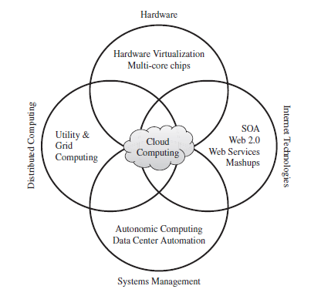

Slide 10
This model brings benefits to both consumers and providers of IT services. Consumers can attain reduction on IT-related costs by choosing to obtain cheaper services from external providers as opposed to heavily investing on IT infrastructure and personnel hiring. The “on-demand” component of this model allows consumers to adapt their IT usage to rapidly increasing or unpredictable computing needs.

Slide 11
Web services can glue together applications running on different messaging product platforms, enabling information from one application to be made available to others, and enabling internal applications to be made available over the Internet.
The purpose of a SOA is to address requirements of loosely coupled, standards-based, and protocol-independent distributed computing users.

Slide 12
In a SOA, software resources are packaged as “services,” which are well-defined, self-contained modules that provide standard business functionality and are independent of the state or context of other services. Services are described in a standard definition language and have a published interface.
Programmable Web is a public repository of service APIs and mashups currently listing thousands of APIs and mashups.

Slide 13
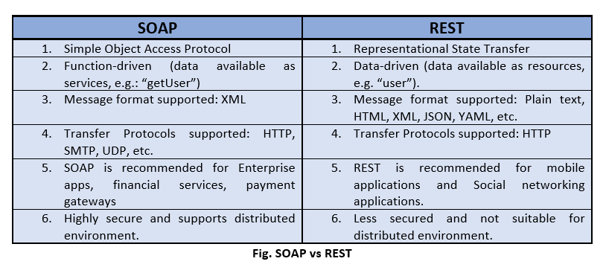
In the consumer Web, information and services may be programmatically aggregated, acting as building blocks of complex compositions, called service mashups. Many service providers, such as Amazon, del.icio.us, Facebook, and Google, make their service APIs publicly accessible using standard protocols such as SOAP(Simple Object Access Protocol) and REST(Representational state transfer)

Slide 14
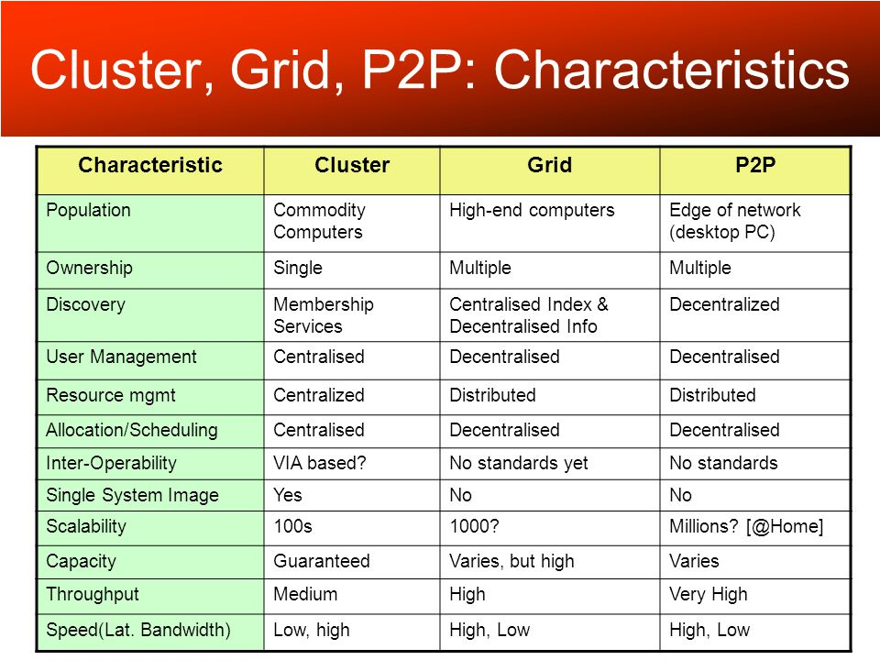
A key aspect of the grid computing services in roots to cloud has been building standard Web services-based protocols that allow distributed resources to be “discovered, accessed, allocated, monitored, accounted for, and billed for, etc., and in general managed as a single virtual system.

Slide 15
The idea of virtualizing a computer system’s resources, including processors, memory, and I/O devices, has been well established for decades, aiming at improving sharing and utilization of computer systems.
The advent of several innovative technologies—multi-core chips, para virtualization, hardware-assisted virtualization, and live migration of VMs—has contributed to an increasing adoption of virtualization on server systems

Slide 16
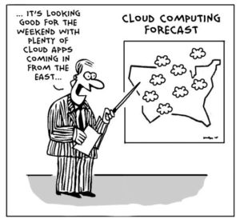

Slide 17
Cloud is a parallel and distributed computing system consisting of a collection of inter-connected and virtualised computers that are dynamically provisioned and presented as one or more unified computing resources based on service-level agreements (SLA) established through negotiation between the service provider and consumers. -Rajkumar buyya

Slide 18
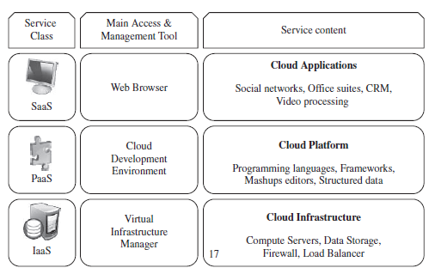
Types of cloud

Slide 19
Cloud computing services are divided into three classes, according to the abstraction level of the capability provided and the service model of providers, namely:
(1) Infrastructure as a Service
(2) Platform as a Service
(3) Software as a Service

Slide 20
These abstraction levels can also be viewed as a layered architecture where services of a higher layer can be composed from services of the underlying layer.
Cloud development environments are built on top of infrastructure services to offer application development and deployment capabilities; in this level, various programming models, libraries, APIs, and mashup editors enable the creation of a range of business, Web, and scientific applications.

Slide 21
Infrastructure-as-a-service
Infrastructure as a Service (IaaS) is the delivery of computer hardware (servers, networking technology, storage, and data center space) as a service. It may also include the delivery of operating systems and virtualization technology to manage the resources.
Dynamic scaling as applied to infrastructure means that the infrastructure can be automatically scaled up or down, based on the requirements of the application.

Slide 22
Platform-as-a-service
With Platform as a Service (PaaS), the provider delivers more than infrastructure. It delivers what you might call a solution stack — an integrated set of software that provides everything a developer needs to build an application — for both software development and runtime.
PaaS can be viewed as an evolution of Web hosting. In recent years, Webhosting companies have provided fairly complete software stacks for developing Websites.

Slide 23
Software-as-a-service
One of the first implementations of cloud services was Software as a Service (SaaS) — business applications that are hosted by the provider and delivered as a service.
At the top of the stack is SaaS. SaaS is a complete application delivered as a service to the service consumer. The service consumer has only to configure some application-specific parameters and manage users.

Slide 24
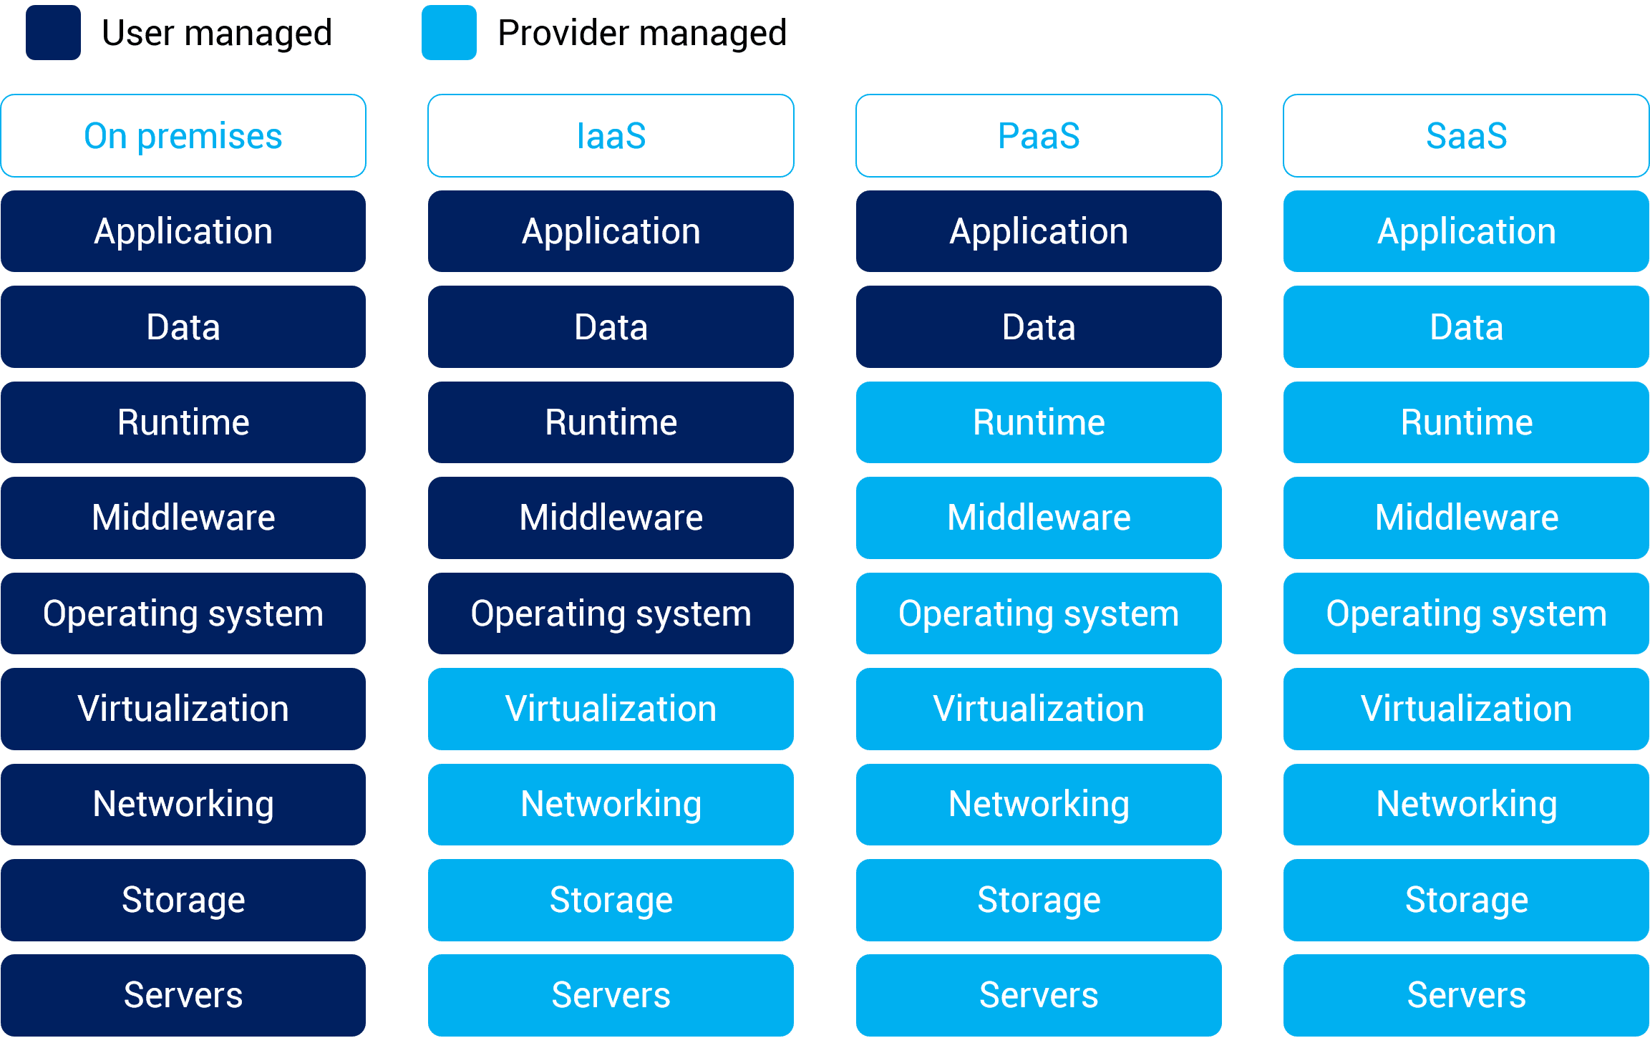

Slide 25
Features of cloud
Certain features of a cloud are essential to enable services that truly represent the cloud computing model and satisfy expectations of consumers, and cloud offerings must be
(i) self-service
(ii) per-usage metered and billed
(iii) elastic
(iv) customizable.

Slide 26
CLOUD INFRASTRUCTURE MANAGEMENT
A key challenge IaaS providers face when building a cloud infrastructure is managing physical and virtual resources, namely servers, storage, and networks
The orchestration* of resources must be performed in a way to rapidly and dynamically provision resources to applications
The software toolkit responsible for this orchestration is called a virtual infrastructure manager.
Notes:
Orchestration is the coordination and management of multiple computer systems, applications and/or services, stringing together multiple tasks in order to execute a larger workflow or process.

Slide 27
Features of infrastructure manager
Virtualization Support-The multi-tenancy aspect of clouds requires multiple customers with disparate requirements to be served by a single hardware infrastructure. Virtualized resources (CPUs, memory, etc.) can be sized and resized with certain flexibility.
Self-Service, On-Demand Resource Provisioning-Self-service access to resources has been perceived as one the most attractive features of clouds.

Slide 28
Multiple Backend Hypervisors- Different virtualization models and tools offer different benefits, drawbacks, and limitations. Thus, some virtual infrsatructure managers provide a uniform management layer.
Storage Virtualization- Virtualizing storage means abstracting logical storage from physical storage. By consolidating all available storage devices in a data center

Slide 29
Dynamic Resource Allocation- Increased awareness of energy consumption in data centers has encouraged the practice of dynamic consolidating VMs in a fewer number of servers.
High Availability and Data Recovery- The high availability (HA) feature of VI managers aims at minimizing application downtime and preventing business disruption.

Slide 30
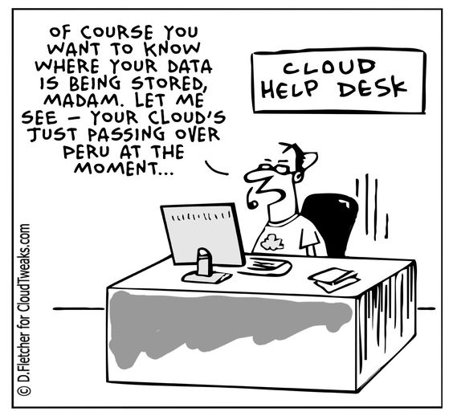

Slide 31
Characteristics of cloud
On-demand self-services: The Cloud computing services does not require any human administrators, user themselves are able to provision, monitor and manage computing resources as needed.
Broad network access: The Computing services are generally provided over standard networks and heterogeneous devices.

Slide 32
Rapid elasticity: The Computing services should have IT resources that are able to scale out and in quickly and on as needed basis. Whenever the user require services it is provided to him and it is scale out as soon as its requirement gets over.
Resource pooling: The IT resource (e.g., networks, servers, storage, applications, and services) present are shared across multiple applications and occupant in an uncommitted manner.

Slide 33
Measured service: The resource utilization is tracked for each application and occupant, it will provide both the user and the resource provider with an account of what has been used. This is done for various reasons like monitoring billing and effective use of resource.

Slide 34
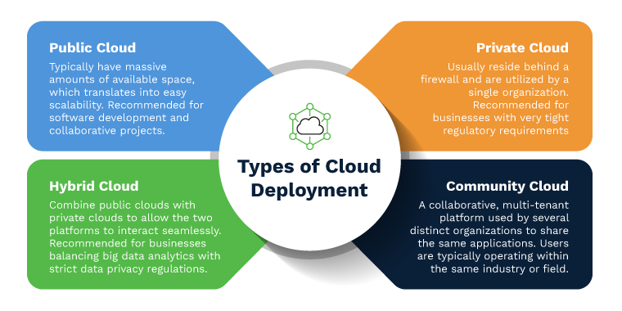

Slide 35
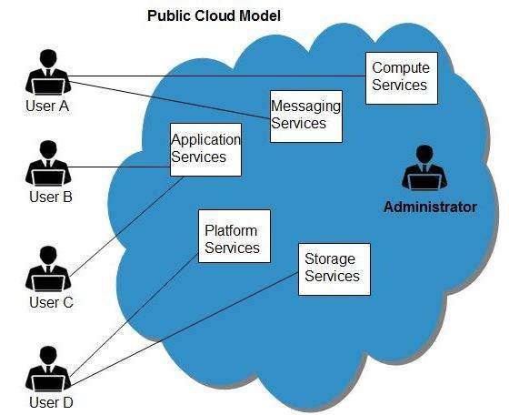
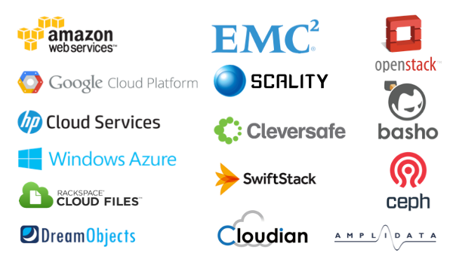

Slide 36
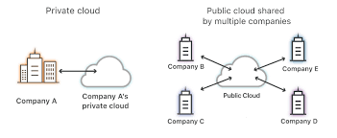
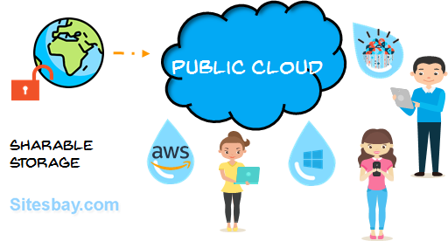

Slide 37
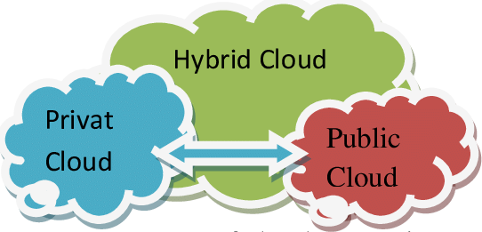

Slide 38
